Slide 1
INLS 623 – Data Mining/Machine Learning
Instructor: Jason Carter
Notes:
Functions

Slide 2
Evolution of Database Technology
YEAR | PURPOSE
1960’s | Network Model, Batch Reports
1970’s | Relational data model, Executive information Systems
1980’s | Application specific DBMS(spatial data, scientific data, image data, …)
1990’s | Terabyte Data warehouses, Object Oriented, middleware and web technology
2000’s | Business Process
2010’s | Sensor DB systems, DBs on embedded systems, large scale pub/ sub systems

Slide 3
Why Mine Data?
Data, Data, Data Every where …
I can’t find data I need – data is scattered over network
I can’t get the data I need
I can’t understand the data I need
I can’t use the data I found

Slide 4
Why Mine Data?
An abundance of data
Super Market Scanners, POS data
Credit cards transactions
Call Center records
ATM Machines
Demographic data
Sensor Networks
Cameras
Web server logs
Customer web site trails
Geographic Information System
National Medical Records
Weather Images
This data occupies
Terabytes - 10^12 bytes
Petabytes - 10^15 bytes
Exabytes - 10^18bytes
Zettabytes - 10^21bytes
Zottabytes -10^24bytes
Walmart - 24 Terabytes

Slide 5
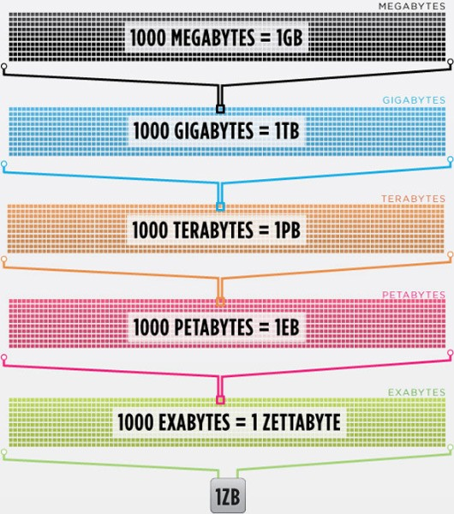
Data is getting bigger:
“Every 2 days we create as much information as we did up to 2003”
– Eric Schmidt, Google

Slide 6
What is Data Mining?
Extraction of interesting information or patterns from data in “large” databases
Process of sorting through large amounts of data and picking out relevant information
Discovering hidden values in databases
It is non-trivial process of identifying valid, novel, useful and understandable patterns in data
Extracting or mining knowledge from large amounts of data

Slide 7
Origins of Data Mining
Draws ideas from machine learning/AI, pattern recognition, statistics, and database systems
Statistics/AI
Machine Learning/Pattern Recognition
Database Systems
Data Mining

Slide 8
Data Mining Steps
Learn application domain:
Relevant prior knowledge and the goals of the application
Data Selection
Creating/Acquiring Target data set
Data Cleaning/Preprocessing
Removing noise and inconsistent data
Choose data mining function (machine learning)
The particular data mining technique
Pattern Evaluation
Evaluation of the interesting patterns
Knowledge Discovery
Visualization and presentation methods are used to present mined knowledge to the user.

Slide 9
Data mining

Slide 10
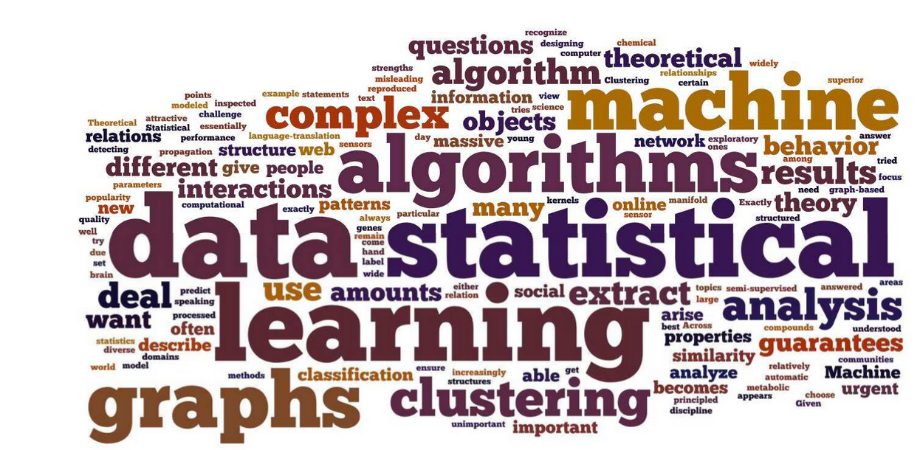
Machine Learning Basics

Slide 11
Application Areas of Machine Learning
Industry
Application
Finance
Credit Card Analysis
Insurance
Fraud Analysis
Telecommunication
Call record analysis

Slide 12
More Applications
Spam Detection
Credit Card Fraud Detection
Digit Recognition
Speech Understanding (Google now, Siri)
Face Detection
Product Recommendation
Medical Diagnosis
Stock Trading
Credit Assessment
Customer Attrition

Slide 13
Machine learning Tasks
Classification
Regression
Clustering
Association Rules
Summarization
Outlier Analysis

Slide 14
Classification
Finding models (functions) that describe and distinguishes classes or concepts
Goal is to make a future prediction
A computer does not have “past experiences” to learn from, so we must prime the system with some concepts/knowledge from which it can “learn”

Slide 15
Classification
Examples
Credit Card Application details -> Approved or Not Approved
(Debt, Equity, Age, Annual Income, EverFiledForBankruptcy, Approval
Examples
Hospital Adminttance Form patient details -> ICU or Non-ICU
(Age, Gender, Smoker, Drinker, BP, Pulse, Respiration, Chest Pains, Conscious, Admit-to-ICU)

Slide 16
Classification
Classification is known as Supervised Learning
Supervised Learning asks the computer to learn from a Training set when the target variable is supplied
Target variables can be nominal values and continuous values
Nominal Values
True/False, Red/White/Blue, Happy/Sad
Classes/Categories correspond to the different nominal values that a target value can take
Classification/Supervised Learning is determining the class/category from a data vector and assigning it to the target variable

Slide 17
Supervised Learning Approaches
Decision Trees
Random Forest
Support Vector Machines (SVM)
Ensembles of Classifiers
Decision Trees
Naïve Bayes Classifier
Boosting
Nearest Neighbor
Many others

Slide 18
Tree-Based Approaches and Algorithms
Decision trees are one of the most common and popular classification paradigms
A predictive model which maps observations about an item to conclusions about the item’s target variable
Allow data sets to be subdivided on a per component (feature) basis.
Visually represent an upside-down tree, with the root at the top (north pole) and the tree growing downward in a southerly direction.
Each interior node corresponds to a feature, and its children (descendants) represent the values for those features.
The terminal nodes (or leaves) identify the final classification of the target variable (classification tree) or the value for a target variable (regression tree).

Slide 19
Tree Models: Algorithms
Algorithms
Random Forest
Generates a number of decision trees (a forest) from a subset of the data in order to improve the classification rate.
Training set sampling with replacement.
At each split variables are chosen at random to judge whether data vectors have a close relationship or not; hence, each tree is different.
Aggregates the output from many shallow trees (sometimes called stumps).
Bagging Decision Trees
Boosted Trees Boosted Trees
Rotation Forest
Many others

Slide 20
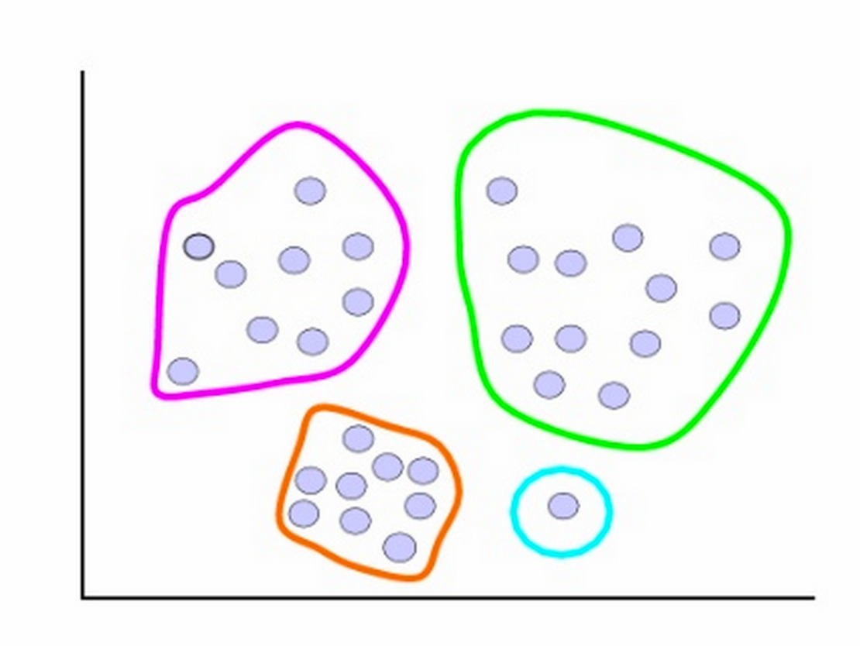
Clustering

Slide 21
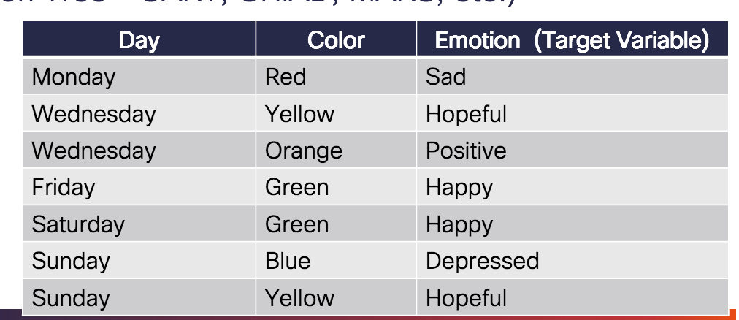
Tree Models
Example Training Set

Slide 22
Regression
When the target variable can take on an infinte range of values, classification is Regression
A statistical process for modeling the relationships among variables.
Focuses on the relationship between a dependent variable and one or more independent variables (i.e. how does a dependent variable change based on a change in an independent variable?).
Identifying which independent variables are related to the dependent variable. Iteratively refined using a measure of the error in the predictions made by the model. Widely used for prediction and forecasting. Lots of math in these approaches!

Slide 23
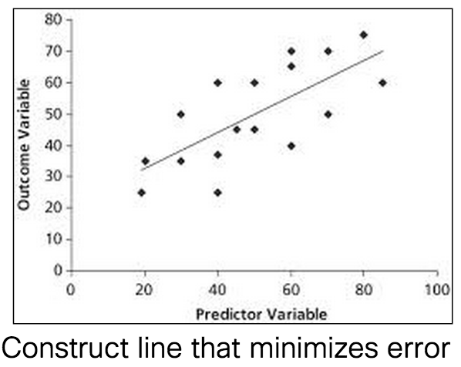
Regression
Approaches
Linear Regression (Multiple Linear Regression)
Least Squares Polynomial Regression Parametric/Non-parametric Regression
Logistic Regression

Slide 24
Clustering
Grouping a set of objects in such a way that the objects in the same group (called a cluster) are more similar (in some sense or another) to each other than to those in other groups (clusters).
Very similar to classification, but the target variable is not defined

Slide 25
Distance Based Clustering
K-means clustering
Partition N data vectors V_{i} into k clusters (groups) such that V_{i} belongs to the cluster C_{j} with the nearest mean Cµ
The mean of a cluster Cµ corresponds to the centroid (component-wise average) of all points that currently reside in that cluster.
Given V₁=(3,2,3), V₂=(6,6,5), and V₃=(21,13,4), the centroid Cµ is ((3+6+21)/3, (2+6+13)/3, (3+5+4)/3)) or (10,7,4).
Iterative algorithm that inserts one vector at a time and stops once no further defections occur.
Notes:
If you are talking about vectors, then we say "componentwise" when we talk about adding. When we add 2 vectors, we write them as points, for example, (1, 2, 3) and (4, 5, 6). To add them, we add "componentwise", meaning we add the numbers in each position together to get a new vector. So, to add (1, 2, 3) and (4, 5, 6), we take:
(1 + 4, 2 + 5, 3 + 6) = (5, 7, 9)

Slide 26
Association Rules
Methods that extract rules which best explain observed relationships between variables in multidimensional data.
These rules can lead to important discoveries and useful associations in large datasets.
Examples
Purchase Analysis (e.g. Amazon, Walmart, Supermarket, etc.),
Web Usage Mining
Intrusion detection

Slide 27
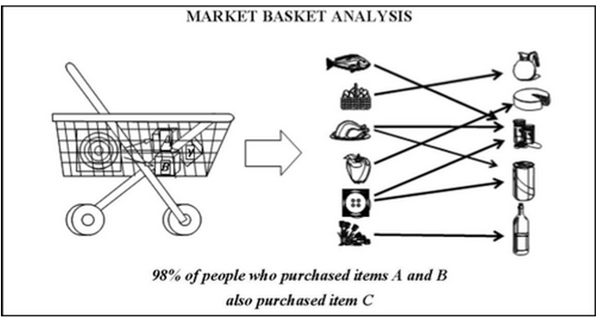
Association Rules
Algorithms
Apriori
FP-growth (Frequent Pattern)
Many others

Slide 28
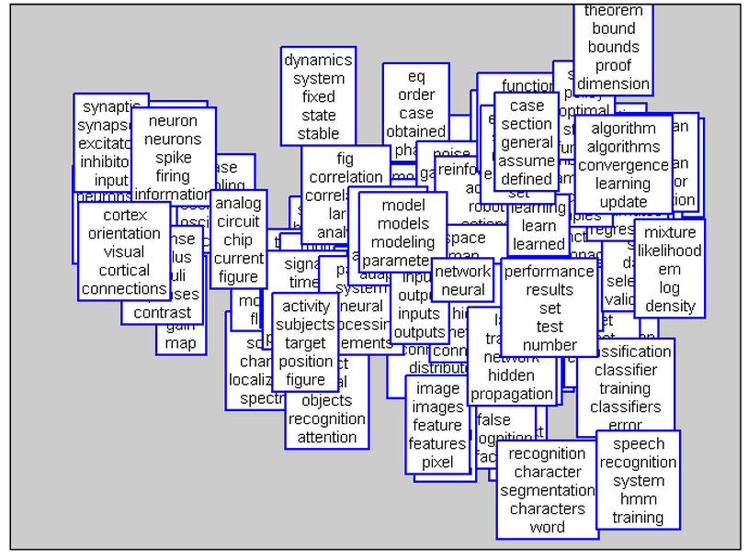
Topic Models
A statistical model for discovering abstract topics that occur in a corpus of documents.
Documents typically encompass multiple topics in different proportions (e.g. Topic1 ≈
25%, Topic2 ≈ 35%, Topic3 ≈ 15%, …)
A topic model encapsulates this knowledge into a mathematical framework.
Examines a corpus of documents and – based on the statistics of the words in each document – discerns what the topics might be and each document’s topic distribution.

Slide 29
Topic Models
Algorithms
Explicit Semantic Analysis, Latent Semantic Analysis, Latent Dirichlet Allocation, Hierarchical Dirichlet Process, Non-negative Matrix Factorization, …
Frameworks
Mallet, Gensim, Stanford Topic Modeling Toolkit,

Slide 30
Frameworks

